Slide 1

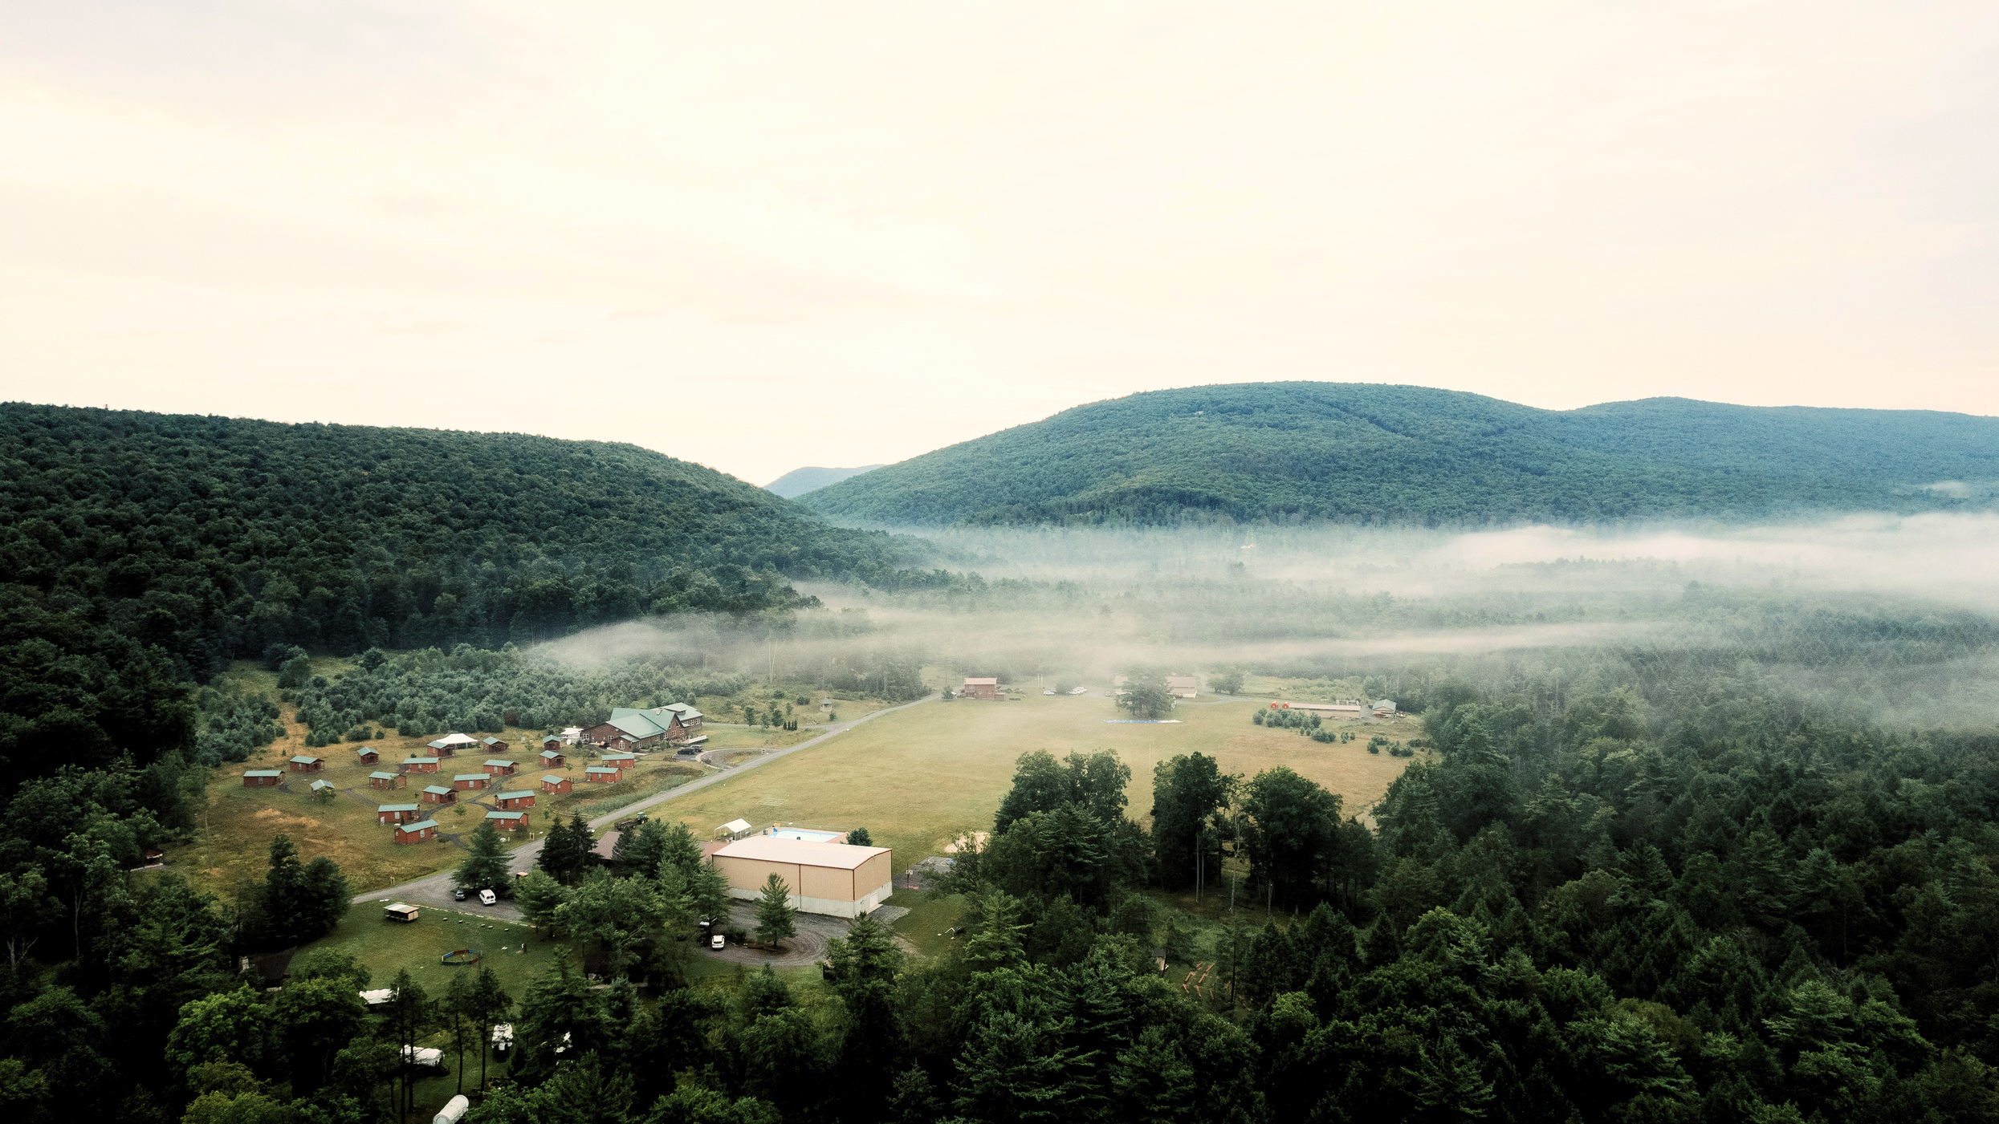
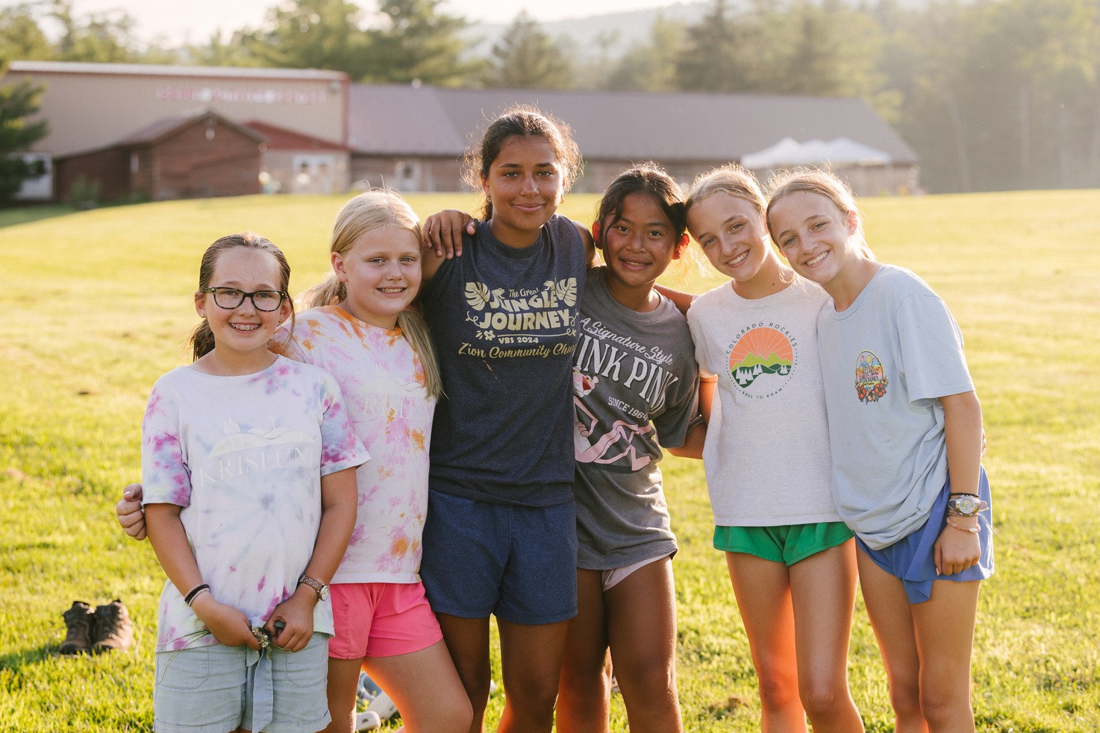
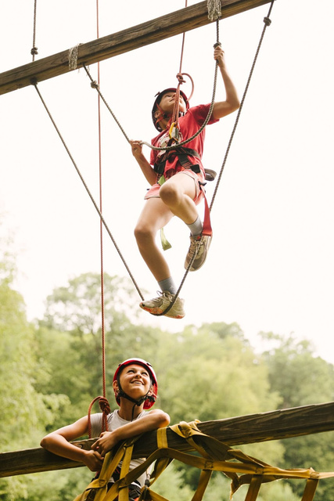
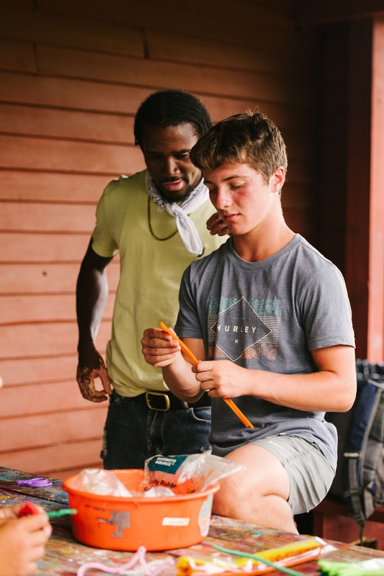
REGISTRATION IS OPEN ONLINE AT KRISLUND.ORG
A SUMMER OF FAITH, FUN, AND ADVENTURE

Slide 2

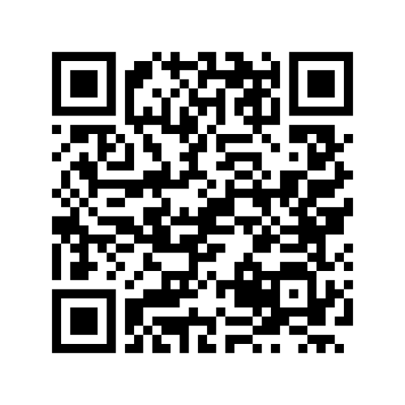
MAY 6 - 7
SUPPORT KRISLUND
The Centre Foundation event that gives more for your donation dollars
during their 2 day event!
Donate to help Krislund at our event site
centregives.org/organizations/230-krislund

Slide 3

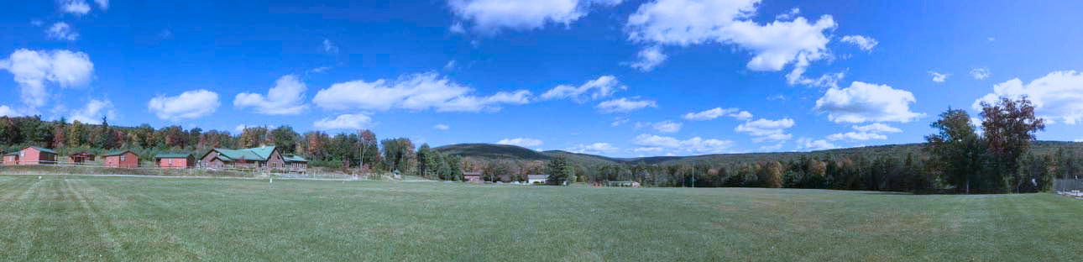

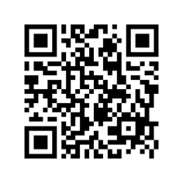
OPEN HOUSE
DAY
SATURDAY, MAY 16TH
10:00 AM - 3:00 PM
Come enjoy a day at camp with friends & family
for fun, activities, & food on us!
HAYRIDE TOURS - COOKOUT - GIANT SWING - MUSIC - ZIPLINE
- CAMP DIRECTOR Q&A & MORE!
SCAN HERE TO LET US KNOW WE’LL SEE YOU AT FAMILY DAY

Slide 4
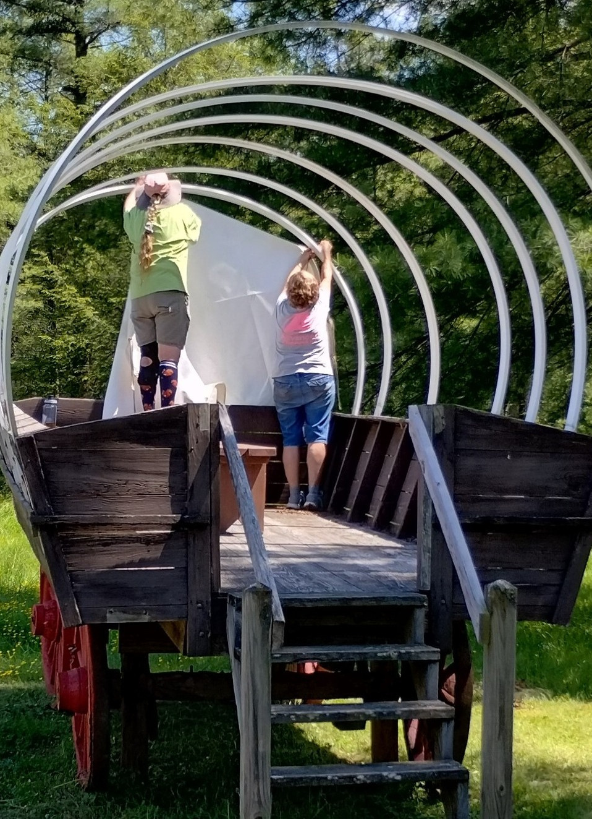
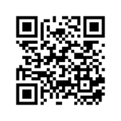
ALUMNI WORK WEEK
May 12th -17th
Come help get camp ready for campers and enjoy a week of fun with camp friends!
There are projects for ALL skill levels!
$100 FOR THE WEEK
-Includes meals and twin bed in the lodge.
$20 FOR JUST A DAY
-Includes meals
Cabin Rental: is available at $20 per night
SCAN HERE
TO LET US KNOW HOW TO PLAN FOR YOUR VISIT - SEE YOU SOON!
For more details call 814-548-6475

Slide 5




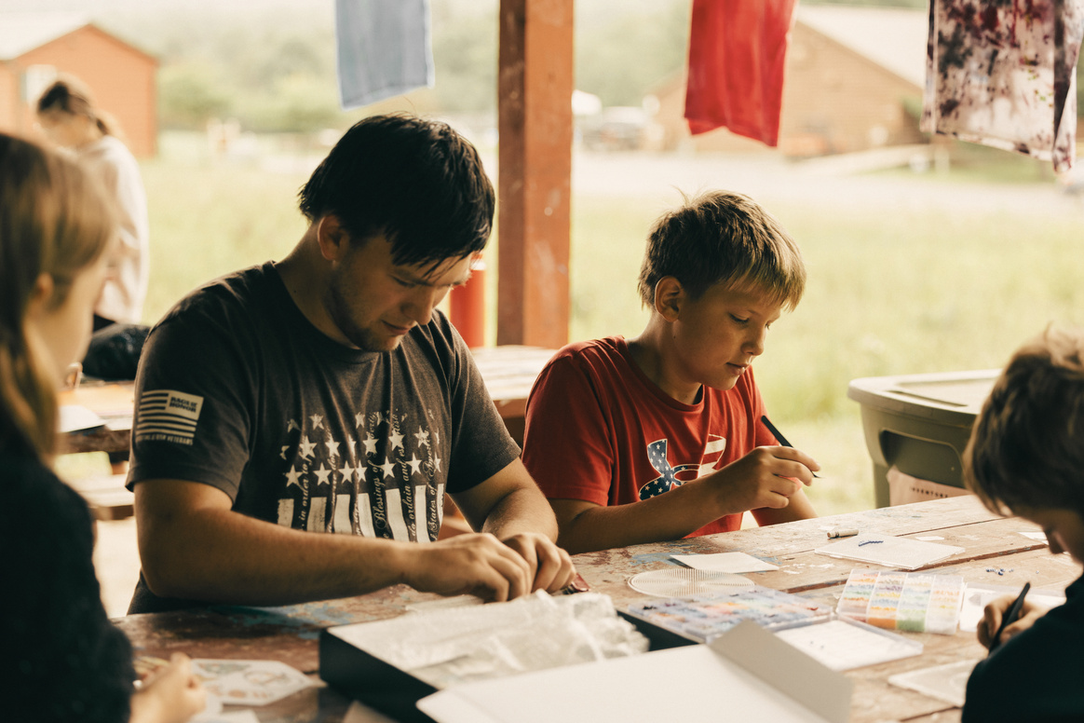





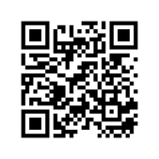


MANDATED REPORTER
TRAINING
Learn Skills That Can Make a Difference For Life
JUNE 11TH
9AM*
WHAT TO EXPECT
SIGN UP NOW
Instruction from an experienced professional
This training will be conducted by CentreSafe and is open to employees, volunteers and supporting churches of Krislund Camp and Retreat Center.
Group activities and open discussion
*Training will be in the Retreat Center. Krislund will offer lunch after the session for $5 a person.
Please register for the session and lunch.
Scan here to register now
For More Information
KRISLUND
814-422-8878
registration@krislund.org

Slide 6
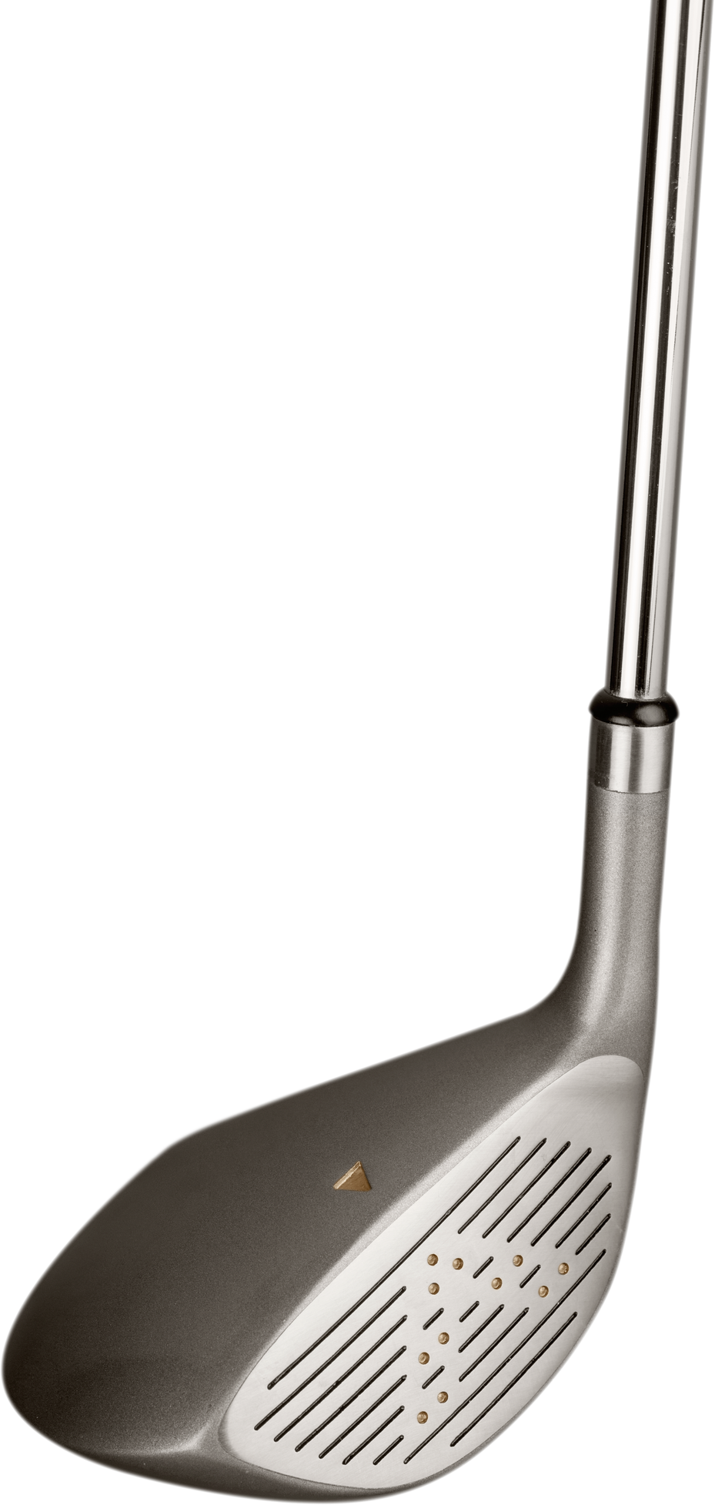






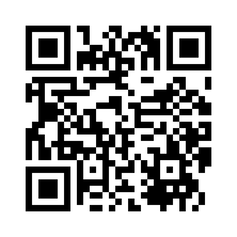
Send Kids To Camp!
2026 “CHIP IN FOR KRISLUND”
GOLF TOURNAMENT
FRIDAY, SEPTEMBER 11
8:00 AM - 3:00 PM
Nittany Country Club
Mingoville, PA
Register Now
Sponsorship opportunities available at birdease.com/krislundgolf
Register online at
birdease.com/krislundgolf
or scan the code
for more info, call (814) 422-8878

